Slide 1

TAG ALONG
Affordable rides & Make new friends

Slide 2
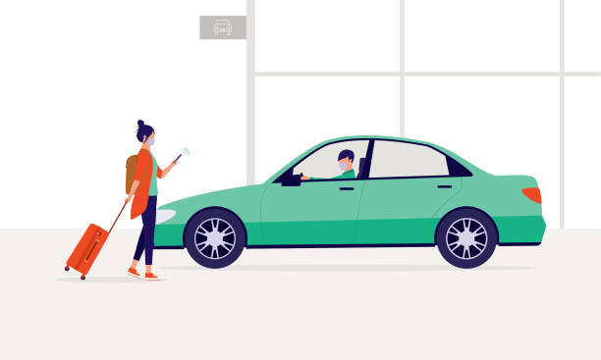
LOOK BACK AT THE PROJECT
Enter Tag Along: a transformative solution designed to bridge the transportation gap within university communities.
Tag Along provides a dynamic platform where members with vehicles can seamlessly connect with those in need of transportation.
A user with a car posts details about an upcoming journey, including the starting point, destination, date, fuel price, available seats, car type, and luggage space.
Meanwhile, fellow members can effortlessly search for rides matching their destinations, assess the date and pricing compatibility, and simply tag along by sending a request.

Slide 3

MIDTERM PROGRESS
Progress began with the development of a Figma model to conceptualize the website's layout and design.
Front-end development commenced, focusing on key components such as the landing page, login, and sign-up using React.
Backend development paralleled front-end efforts, utilizing Django for implementation.
User Story #1 aimed to establish fundamental features for user login and registration.
Dev Tasks included:
Creation of UI for the User Authentication Page - Login Page.
Backend implementation for user authentication on the Login Page.
Design and implementation of UI for the User Authentication Page - Registration Page.
Backend development for user registration.
Integration of UI elements for login functionality.
Backend setup for the login feature.

Slide 4
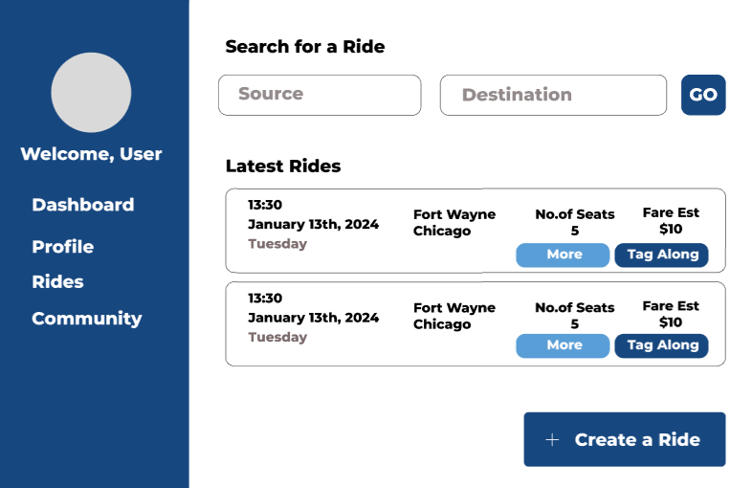
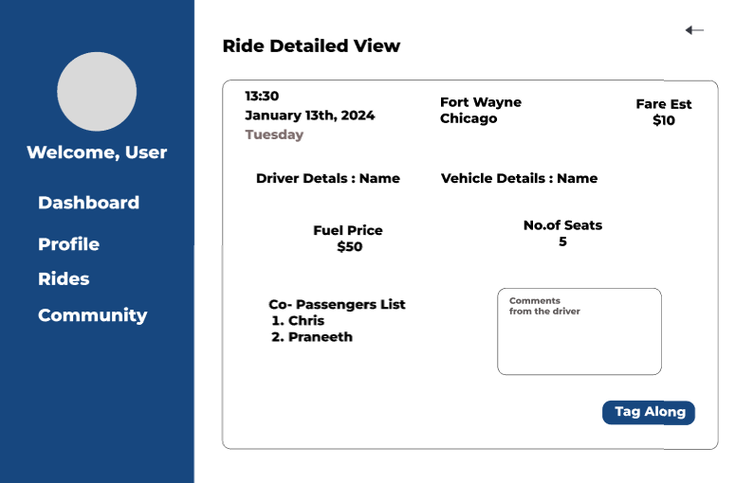
CURRENT/FUTURE MODIFICATIONS
Dashboard Development:
Create user-friendly interface.
Implement ride search feature.
Detailed Ride View:
Design and implement detailed ride view dashboard.
Backend Integration:
Develop APIs for data retrieval.
Ensure secure data transmission.
User Interaction:
Enable ride requests, acceptances, and messaging.
Real-time Updates:
Integrate real-time notifications.
Utilize WebSockets for communication.
Testing and QA:
Conduct comprehensive testing.
Gather user feedback.
Documentation and Training:
Prepare usage documentation.
Provide user training sessions.
Feedback and Improvement:
Iterate based on user feedback.
Enhance usability and features.

Slide 5
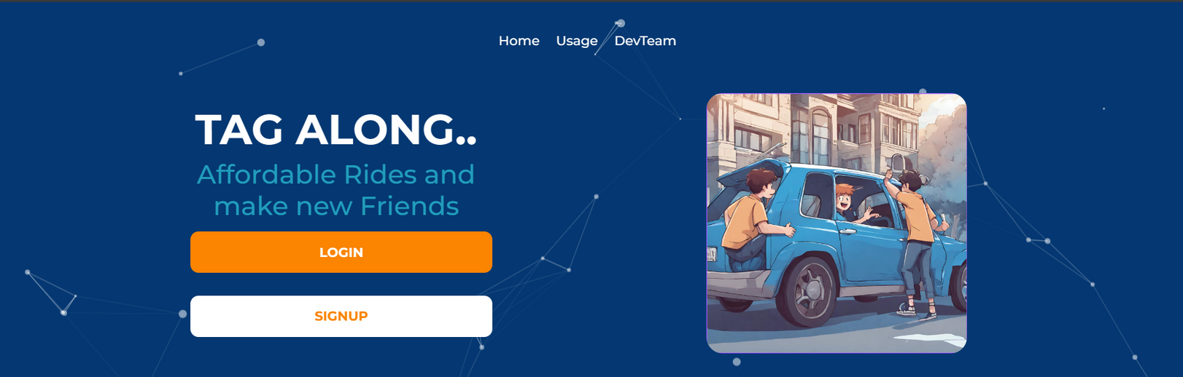
DEMO

Slide 6
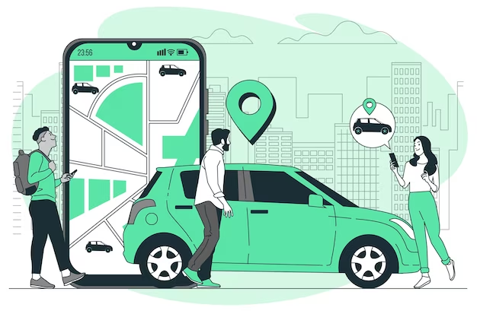
THANK YOU
The project aims to revolutionize transportation within university communities through the development of Tag Along, a dynamic platform connecting users with available rides.
By implementing key features such as a user-friendly dashboard with ride search functionality and detailed ride views, the project enhances user experience and accessibility.
With backend integration ensuring secure data management and real-time updates facilitating seamless communication, Tag Along offers a comprehensive solution for users seeking affordable rides and social connections.
Through rigorous testing, documentation, and iterative improvements based on user feedback, the project ensures the delivery of a high-quality and user-centric platform, poised to make a significant impact in university transportation ecosystems.

Slide 7




MEET OUR TEAM
Christopher Mukkungal Geever
Naga Sai Praneeth Bayana
Bala Krishna Veligatla
Neha Rajeeva

